Slide 2
Students will be able to:

Slide 3
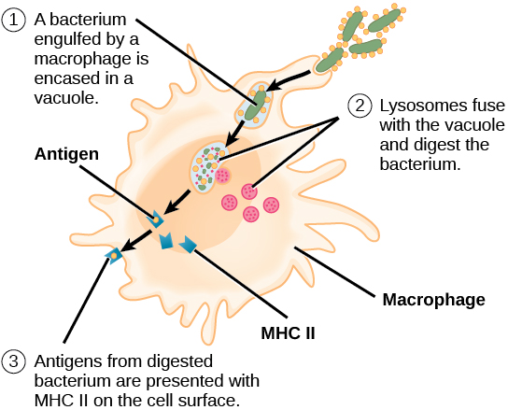
The Immune Response
Once the first line of defence is breached and the second line of defence is activated, antigen presentation occurs in the lymph system, which results in a specific immune response.
Notes:
Teacher Cue – refer to the vocabulary box as you read through and “unpack” the definition provided. Use hand gestures to emphasise the ”2 or more”, “mixed” and “separated” parts of the definition.
Have students complete CFU 1 as a pair-share, then record these definitions & examples as notes (with diagrams) if desired.
CFU 2 – pair-share, then whiteboards for answers – call on non-volunteers.

Slide 4
The Immune Response
Macrophages are involved in both non-specific and specific immunity.
T-lymphocytes and B-lymphocytes are involved in the specific immune response.

Slide 5
The Immune Response
An antigen is any substance capable of producing a specific immune response.
Antigens are substances on the surface of cell membranes. So, often they are proteins, but they can be carbohydrates or lipids.

Slide 6
The Immune Response
Antigens are found on the surface of all cells, including those produced by the individual. Those belonging to the individual are self- or non-foreign antigens.
The body is programmed to recognise these and not attack them. Those not belonging to the body e.g., on the surface of pathogens, are called non-self or foreign antigens.

Slide 7
The Immune Response
An autoimmune disorder is caused by the body not recognising self-antigens and attacking its own tissues.

Slide 8
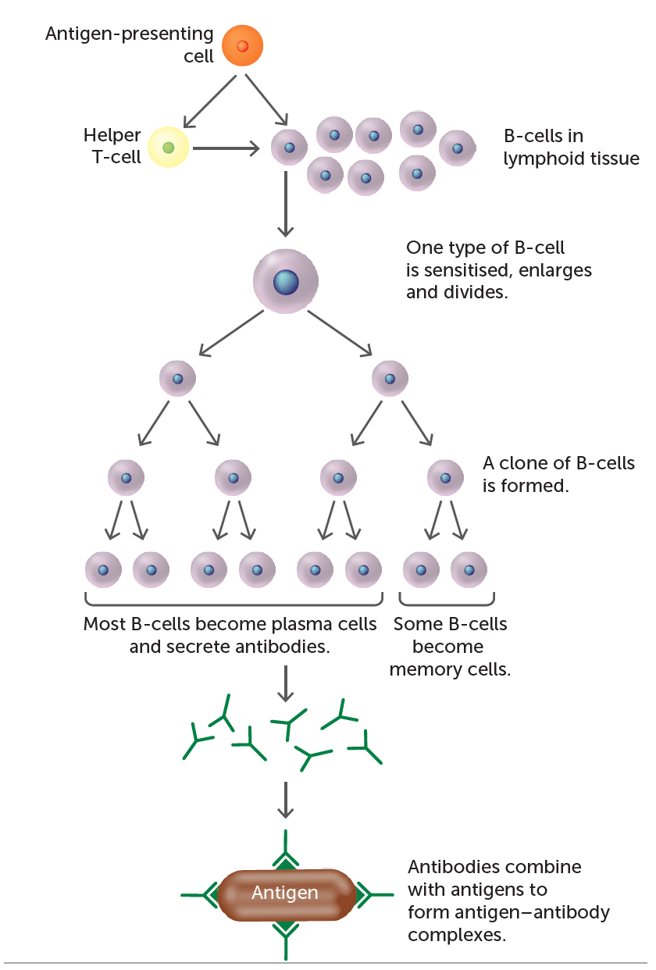
Humoral (cell-mediated) response
There are two types of specific immune response:
1. Humoral (cell-mediated) response
B cells are stimulated by a foreign substance (antigen (capable of producing an immune response)) which reaches lymphoid tissue. This is called antigen presentation.
Sensitised B (lymphocyte) cells are produced and mature in bone marrow.
B cells are stimulated and rapidly divide by mitosis to produce plasma cells and some memory cells.
Plasma cells produce antibodies (specialised proteins produced in response to a non-self antigen) which are released into the bloodstream.
Antibodies inactivate or destroy non-self antigens by:
Binding to viral binding sites or to bacterial antigens.
Agglutination: clumping non-self particles together. Reacting with soluble antigens and making them insoluble.
Coat bacteria enhancing phagocytosis. (1st three points also enhance phagocytosis).
Inhibiting reactions with other cells or compounds by breakdown of non-self.
This is a primary response. It takes time to develop the antibodies and so the
Memory cells result in a much faster response should the same non-self antigen invade the body again.

Slide 9
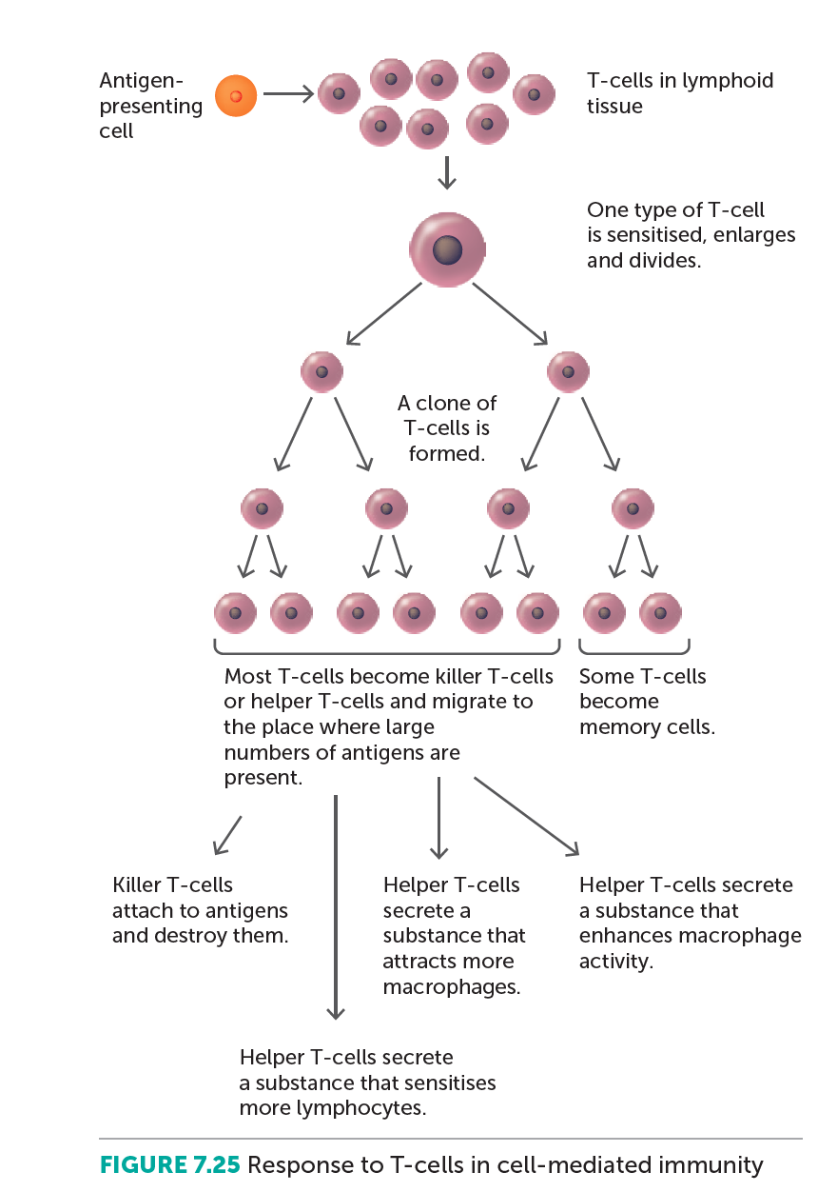
2. Cell mediated response:
This provides resistance to the intra-cellular phase of bacterial and viral infections.
Foreign antigens reach lymphoid tissue.
T cells are sensitised and undergo rapid cell division. Most of the cells produced are killer T cells, which destroy the antigen. Other T cells become helper T cells, which sensitise lymphocytes, intensify response and promote phagocytosis, and suppressor T cells, which inhibit B and T cells to slow down the immune response once the infection has been dealt with effectively.
Some T cells form memory cells which initiate a faster secondary response should the same antigen re-enter the body.

Slide 10
Types of Immunity
Immunity is the resistance to infection by invading micro-organism.
Immunity can be natural, i.e., there is no human intervention, or artificial, i.e., as a result of being given an antibody or antigen.
Passive immunity is when the body receives antibodies from another source. Active immunity is when the body produces its own antibodies in response to a non-self antigen.

Slide 11
Types of Immunity
 | Natural | Artificial
Passive | Occurs without human intervention. Body gets antibodies produced by someone else. Not long lasting. Example: antibodies enter the bloodstream across the placenta or in breast milk. | Occurs when someone is given antibodies Body gets antibodies produced by someone else. Not long lasting. Example: influenza antibodies injected into bloodstream.
Active | Occurs without human intervention. Body makes its own antibodies in response to a non-self antigen. Long lasting immunity because of memory cells. Example: Contracting chickenpox and producing antibodies to it. | Occurs when someone is given antigens. Body makes its own antibodies in response to a non-self antigen. Long lasting immunity because of memory cells. Example: Antigens given by vaccination, e.g. living attenuated MMR antigens injected into bloodstream.
Notes:
CFU – read through the slide, have students look closely at the diagram, then allow think time, before asking them to explain it to their partner using the key terms pure substance and mixture. Call on non-volunteers and provide feedback, encouraging detailed responses in full sentence form.

